Slide 1



ITC 510 Software Data Modeling
Vamshi Jaligama
Kotha Sai Krishna Reddy
Abhishek raj Sampath

Slide 2
Contents:
What is exploratory data analysis and why ?
Dataset
Libraries used
outcome

Slide 3
What is exploratory data analysis and why ?
Exploratory Data Analysis (EDA) is an approach to analyzing datasets to summarize their main characteristics, often with visual methods. EDA is used for seeing what the data can tell us before the modeling task.

Slide 4
Dataset: Netflix Movies and TV Shows
show_id
Type
Title
Director
cast
country
date_added
release_year
rating
duration
listed_in
description

Slide 5
Contd…
show_id : this column depicts the unique id of the shows in the Netflix which will be used by Netflix to select for user’s response.
Type : this column has the type whether it is movie or Tv Show
Title : this column has the movie titles.
Director :this column contains the director names
Cast :this column has the main cast of the movie.

Slide 6
Contd….
The dataset contains over 6234 titles, 12 descriptions. After a quick view of the data frames, it looks like a typical movie/TV shows data frame without ratings. We can also see that there are Nan values in some columns.

Slide 7
Data cleaning
The process of finding incorrect, incomplete, inaccurate, irrelevant, or missing data and then updating, replacing, or removing it as needed is known as data cleaning. Data cleansing is regarded as a fundamental component of data science.
There are multiple columns with missing / NAN values and some of the columns are director , cast , country , date-added , rating , duration

Slide 8
Data cleaning
Replacing the missing country with the mode values
Removing the date_added rows
Replacing the missing rating with mode values.
Removing the missing duration rows as they are few missing values

Slide 9
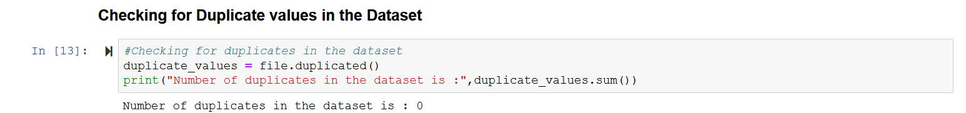
Checking for Duplicate values in the dataset

Slide 10
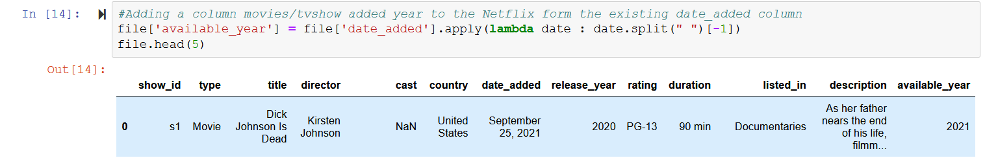
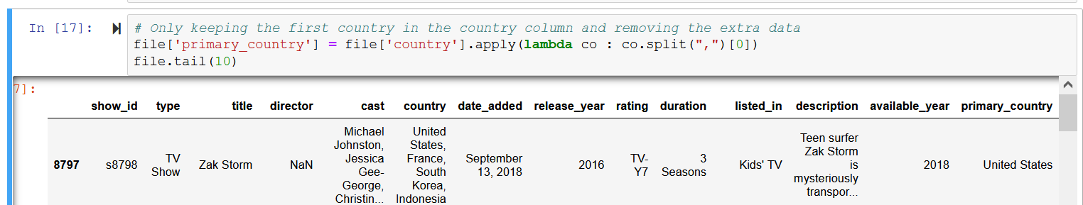
ADDING COLUMNS FOR EDA

Slide 11
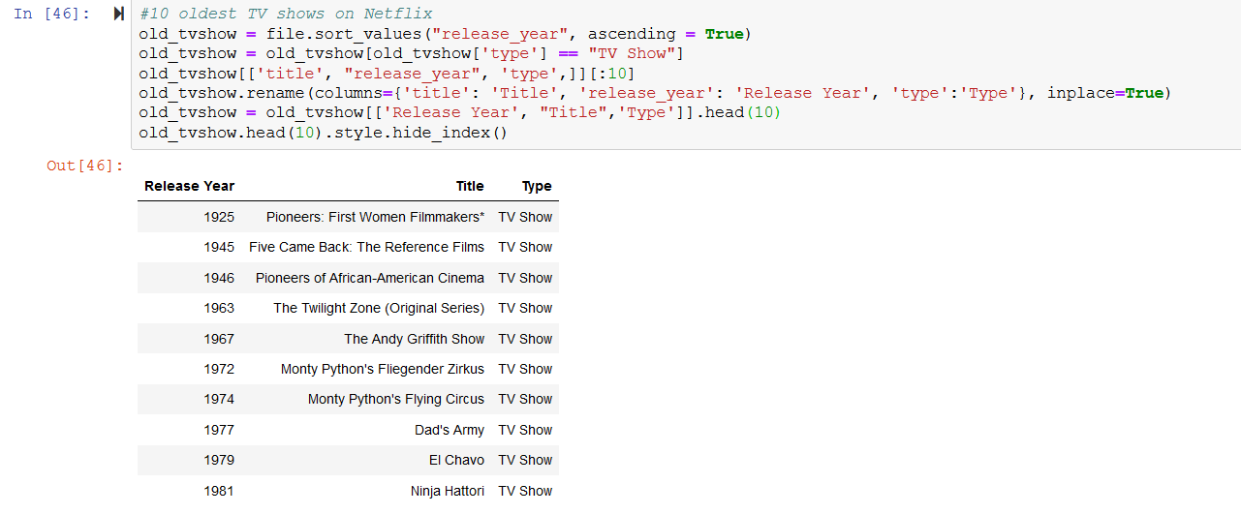
TOP 10 OLDEST TV SHOWS

Slide 12
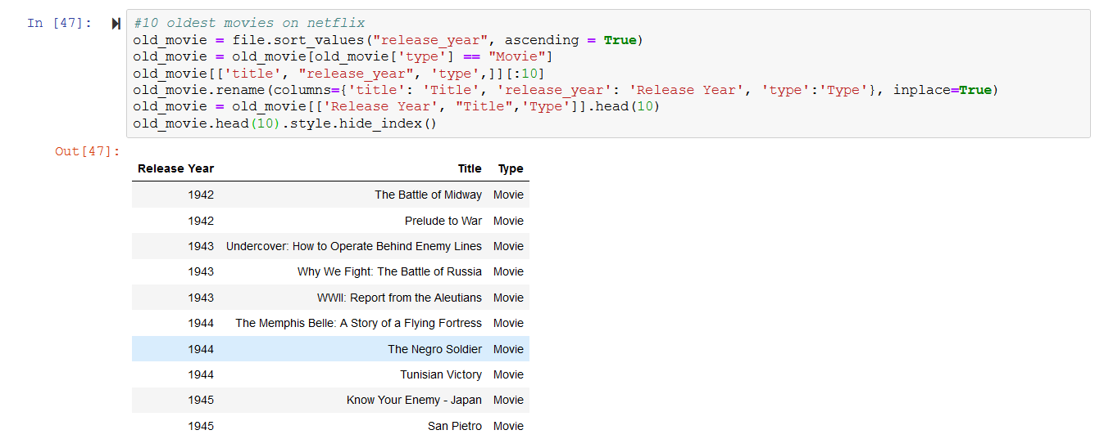
TOP 10 OLDEST MOVIES

Slide 13
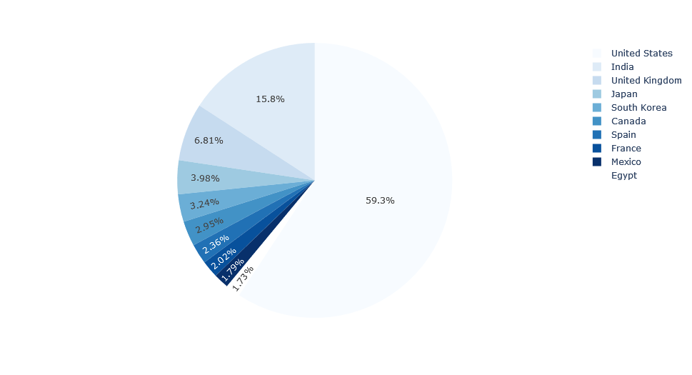
Netflix content country wise

Slide 14
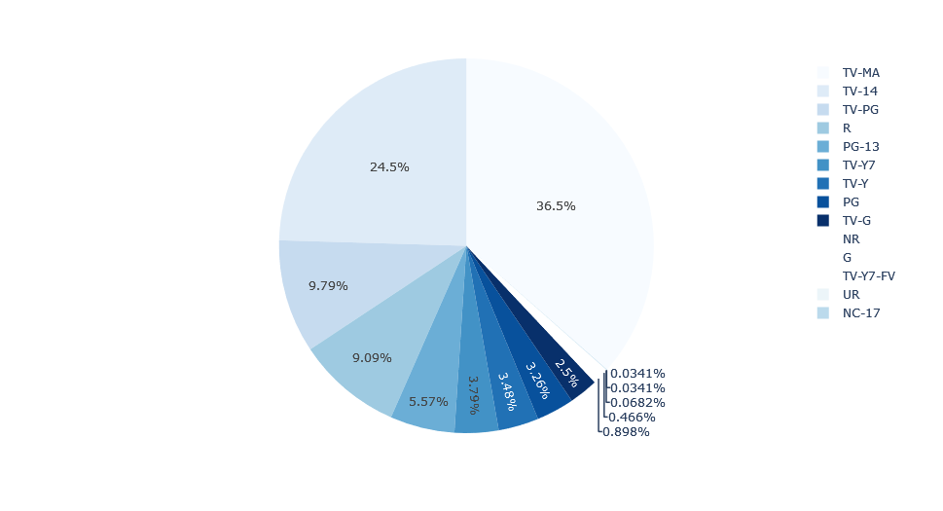
contents made with rating

Slide 15
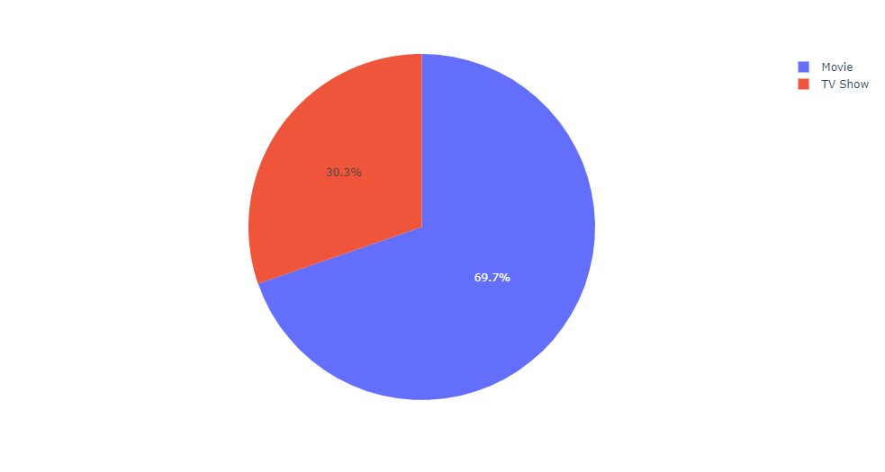
Distribution of type of content

Slide 16
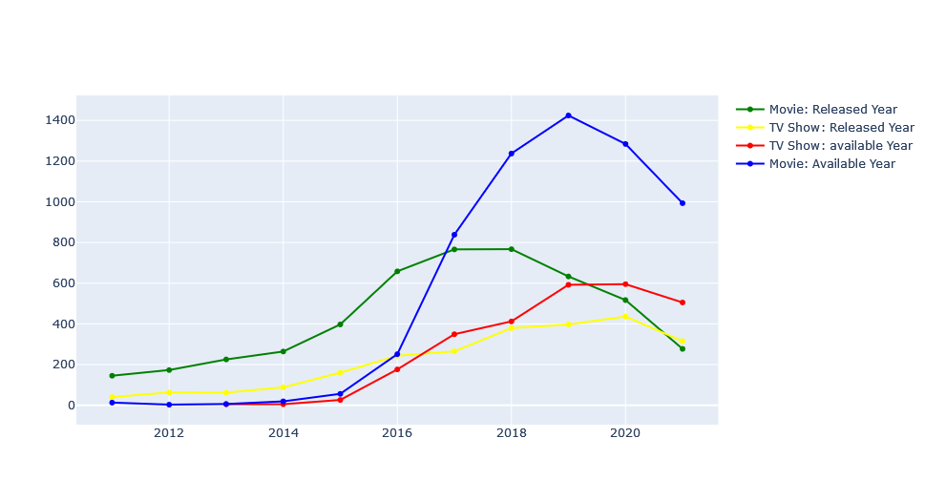
RELEASED YEAR OF MOVIES AND TV SHOWS

Slide 17
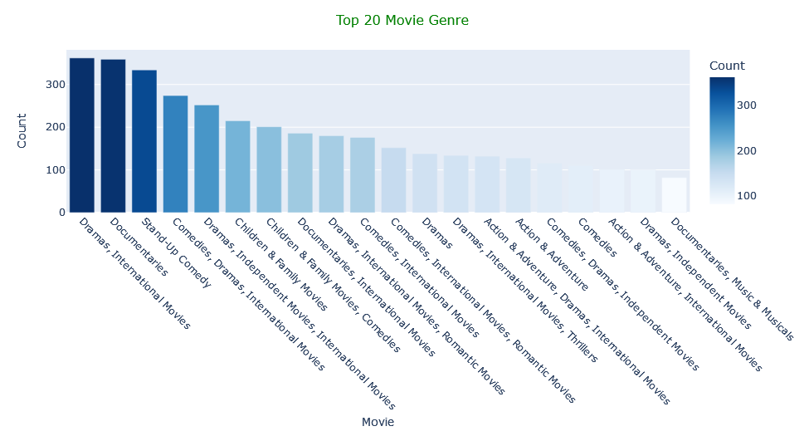
Top 20 Movie Genre

Slide 18
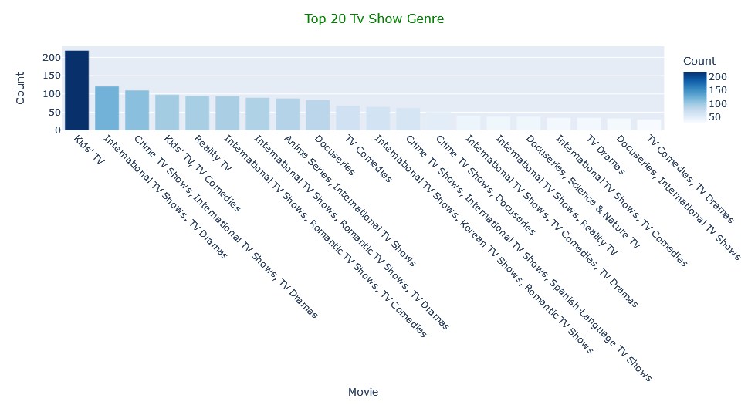
TOP 20 TV SHOW GENRE

Slide 19
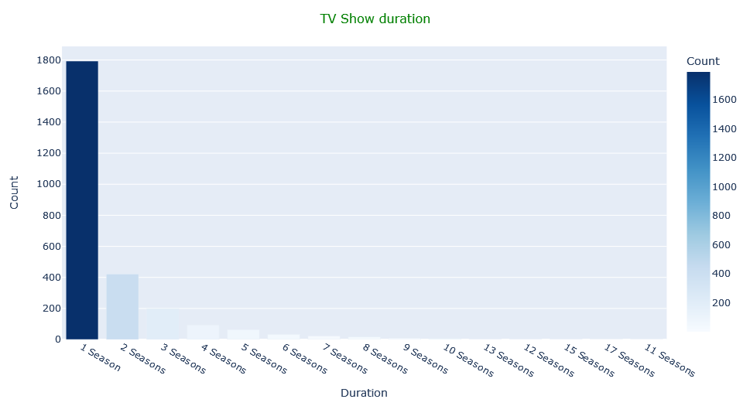
Distribution of duration

Slide 20
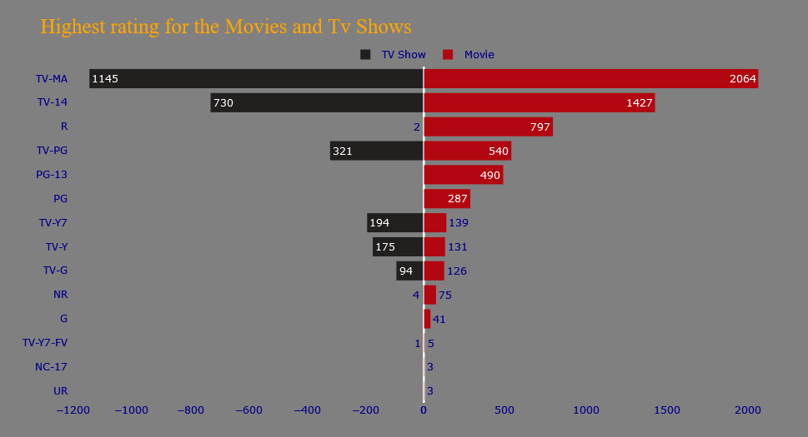
THE HIGHEST RATING OF TV SHOWS OR MOVIES

Slide 21
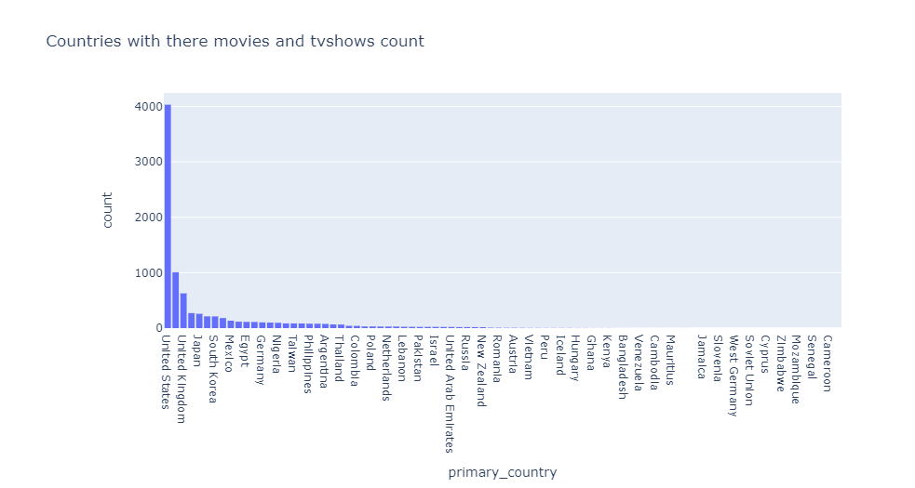
countries with count of movies and tv shows

Slide 22
Conclusion
We have drawn many interesting inferences from the dataset :
The country by the amount of the produces content is the United States,
Drama,International Movies is a genre that is mostly in Netflix,
The largest count of Netflix content is made with a “TV-14” rating,
The most popular actor on Netflix TV Shows based on the number of titles is Takahiro Sakurai,
The most popular actor on Netflix movie, based on the number of titles, is Anupam Kher.

Slide 23

Thank you

